Slide 1
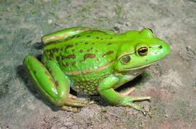

Slide 3
DISABLING the power of FEAR
Ask yourself if you want to change/be free
Make a definite decision that you will not fear
Focus on things that don’t give power to your fears-(renew your mind. use your senses)
Learn what it means to fear the Lord
Let God perfect (mature/complete) you in love

